Slide 1
DATABASE MANAGEMENT SYSTEM
Data Redundancy Revisited, Indexes (Chapter 03)

Slide 2
Objectives
2
To discuss data redundancy in more detail using examples
To understand what Indexes are and why they are important in Relational Databases
To cover the rules that must be met by Relational DBMS vendors in order for their product to be considered Relational DBMS (RDBMS)

Slide 3
Data Redundancy Revisited
3
Redundancy leads to data anomalies, anomalies can destroy the effectiveness of the database.
Relational databases control data redundancies by using common attributes shared by tables, called foreign keys.
Proper use of foreign keys minimizes data redundancies, thus minimizing chance that destructive data anomalies will develop.
If you delete an attribute and the original information can still be generated through relational algebra, the inclusion of that attribute would be redundant.
Controlled redundancies are often designed as part of the system to ensure transaction speed and/or information requirements.

Slide 4
Data Redundancy Revisited (contd.)
4
Reconcile three often contradictory requirements: design elegance, processing speed, and information requirements.
There are times when the level of data redundancy must actually be increased to make the database serve crucial information purposes.
There are also times when data redundancies seem to exist to preserve the historical accuracy of the data.

Slide 5
Example
Customer ame | Customer Area Code | Customer Phone | Invoice Date | Product Desc | Product Price | Units Purchased | Units in hand
Khalid | 021 | 36242734 | 23- Feb- 2015 | Colgate | 75 | 3 | 10
Khalid | 021 | 36242734 | 23- Feb- 2015 | Dettol | 120 | 1 | 6
Waseem | 051 | 4865778 | 23- Feb- 2015 | Vacuum Cleaner | 8000 | 1 | 5
Waseem | 051 | 4865778 | 24- Feb- 2015 | Colgate | 75 | 2 | 8
Khalid | 021 | 36242734 | 28- Feb- 2015 | Rice | 750 | 1 | 15
5
N

Slide 6
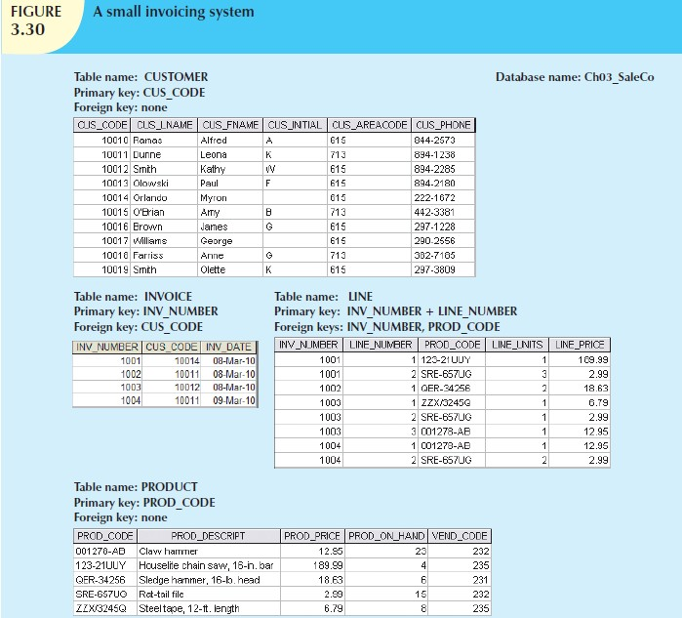
Data Redundancy Revisited (contd.)
6

Slide 7
Data Redundancy Revisited (contd.)
7
Consider the Example in Figure 3.30
Why does that same product price occur again in the LINE
table?
Answer: For keeping the history
In LINE table, would the combination of INV_NUMBER and PROD_CODE be a sufficient composite primary key? If yes then why the LINE_NUMBER attribute was used?
Answer:
Automatic generation of LINE_NUMBER.
Keeping the order of items sold in the same order as that on the
receipt given to user.

Slide 8
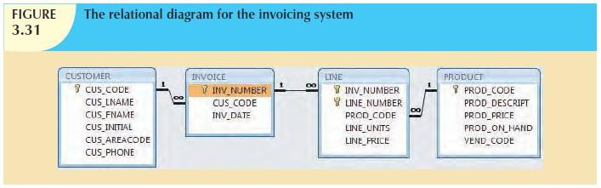
Data Redundancy Revisited (contd.)
8

Slide 9
Indexes
9
Example 1: Does it make sense to look through every book in the library until you find the one you want?
Of course not, you use the library’s catalog, which is indexed by title, topic, and author.
The index (in either a manual or a computer system) points you to the book’s location, thereby making retrieval of the book a quick and simple matter.
Example 2: Suppose you want to find a topic, such as “ER
model,” in this book. Does it make sense to read through every page until you stumble across the topic?
Of course not; it is much simpler to go to the book’s index, look up the phrase ER model, and read the page references that point you to the appropriate pages.

Slide 10
Indexes (contd.)
10
An index is an orderly arrangement used to logically access rows in a table.
An index is composed of an index key and a set of pointers.
An index is an ordered arrangement of keys and pointers.
Each key points to the location of data identified by the key.
◉ For example, suppose you want to look up all of the paintings created by a given painter in Figure 3.19.
Without an index, you must read each row in the PAINTING table
and see if the PAINTER_NUM matches the requested painter. However, if you index the PAINTER table and use the index key PAINTER_NUM, you merely need to look up the appropriate PAINTER_NUM in the index and find the matching pointers.

Slide 11
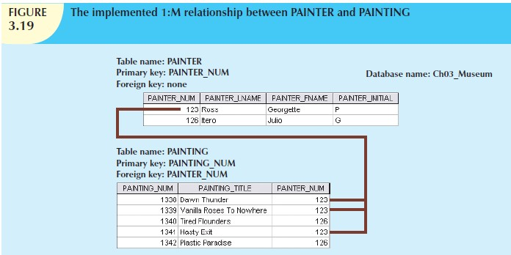
Indexes (contd.)
11

Slide 12
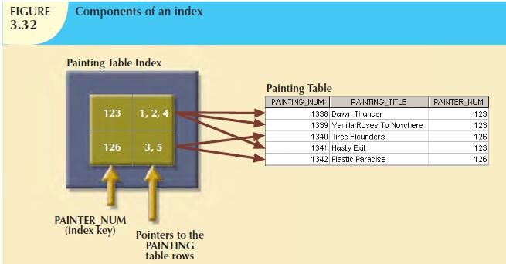
Indexes (contd.)
12
Conceptually, an index resembles what is given in Figure 3.32.
PAINTER_NUM index key value (123) is found in records 1, 2, and 4 of the PAINTING table.
PAINTER_NUM index key value (126) is found in records 3 and 5.

Slide 13
Indexes (contd.)
13
When you define a table’s primary key, the DBMS automatically creates a unique index on the primary key column(s) you declared.
A unique index is an index in which the index key can have only one pointer value (row) associated with it. (The index in Figure 3.32 is not a unique index because the PAINTER_NUM has multiple pointer values associated with it.)
A table can have many indexes, but each index is associated with only one table.
The index key can have multiple attributes (composite index).

Slide 14
Codd’s Relational Database Rules
14
In 1985, Dr. E. F. Codd published 12 rules to define a relational database system.
His concern: vendors marketing products as “relational” without meeting standards.
Even the dominant database vendors do not fully support all 12 rules.
RULE | RULE NAME | DESCRIPTION
1. | Information | All information in a relational database must be logically represented as column values in rows within tables.
2. | Guaranteed Access | Every value in a table is guaranteed to be accessible through a combination of table name, primary key value, and column name.
3. | Systematic Treatment of Nulls | Nulls must be represented and treated in a systematic way, independent of data type.
4. | Dynamic Online Catalog Based on the Relational Model | The metadata must be stored and managed as ordinary data, that is, in tables within the database. Such data must be available to authorized users using the standard database relational language.

Slide 15
Codd’s Relational Database Rules
(contd.)
15
RULE | RULE NAME | DESCRIPTION
5. | Comprehensive Data Sublanguage | The relational database may support many languages. However, it must support one well-defined, declarative language with support for data definition, view definition, data manipulation (interactive and by program), integrity constraints, authorization, and transaction management (begin, commit, and rollback).
6. | View Updating | Any view that is theoretically updatable must be updatable through the system.
7. | High-Level Insert, Update, and Delete | The database must support set-level inserts, updates, and deletes.
8. | Physical Data Independence | Application programs and ad hoc facilities are logically unaffected when physical access methods or storage structures are changed.

Slide 16
Codd’s Relational Database Rules
(contd.)
16
RULE | RULE NAME | DESCRIPTION
9. | Logical Data Independence | Application programs and ad hoc facilities are logically unaffected when changes are made to the table structures that preserve the original table values (changing order of columns or inserting columns).
10. | Integrity Independence | All relational integrity constraints must be definable in the relational language and stored in the system catalog, not at the application level.
11. | Distribution Independence | The end users and application programs are unaware and unaffected by the data location (distributed vs. local databases).
12. | Nonsubversion | If the system supports low-level access to the data, there must not be a way to bypass the integrity rules of the database.
 | Rule Zero | All preceding rules are based on the notion that in order for a database to be considered relational, it must use its relational facilities exclusively to manage the database.

Slide 17
Conclusion
17
In this Lecture, we learned that…
Data redundancy, if not controlled, can destroy the effectiveness
of data
Data redundancy is sometimes increased to meet requirements
An index is an orderly arrangement used to logically access rows in a table
An index is composed of an index key and a set of pointers
In a Unique index, index key can only one pointer value
In 1985, Dr. E. F. Codd published 12 rules to define a relational database system
These rules can be used to validate if the market DBMS really meets the standards of a Relational DBMS (RDBMS).

